Slide 2

Arduino Basics
Achilles C. Macunlay

Slide 3
Scope
PART 1: Introduction
What is a Microcontroller?
What is Arduino?
Kinds of Arduino Boards
PART 2: The Arduino Uno Board
Specifications
Pin Configuration
Ways to Power the Board
PART 3: Programming Basics
Common Data Types
Control Statements
Common Loop Statements
PART 4: Demo (Shift Register)
What is a Shift Register?
How Does a Shift Register Work?
Setup, Code, and Explanation

Slide 4

Part 1: Introduction

Slide 5
Part 1: Introduction
What is a Microcontroller?
A microcontroller unit (MCU) is a compact integrated circuit (IC) used to govern specific operation/s in an embedded system.
A typical MCU includes a processor, memory and input/output (I/O) peripherals on a single chip.

Slide 6

Part 1: Introduction
Microcontrollers or Microprocessors?
Microprocessors are commonly used for intensive processing such as personal computers, laptops, mobile devices, and video games.
Microcontrollers are usually used when the given task is fixed and predefined such as commercial appliances.

Slide 7
Part 1: Introduction
What is Arduino?
Arduino is an open-source electronics platform based on easy-to-use hardware and software.
Arduino boards can read inputs such as light on a sensor, a finger on a button, or a Twitter message, and turn it into an output like activating a motor, turning on an LED, or publishing something online.

Slide 8
Part 1: Introduction
Kinds of Arduino Boards
When choosing a board for a project, factors such as price, compatibility, power efficiency, and portability should be considered.
The boards shown in the next slides are the commonly used ones for projects…

Slide 9
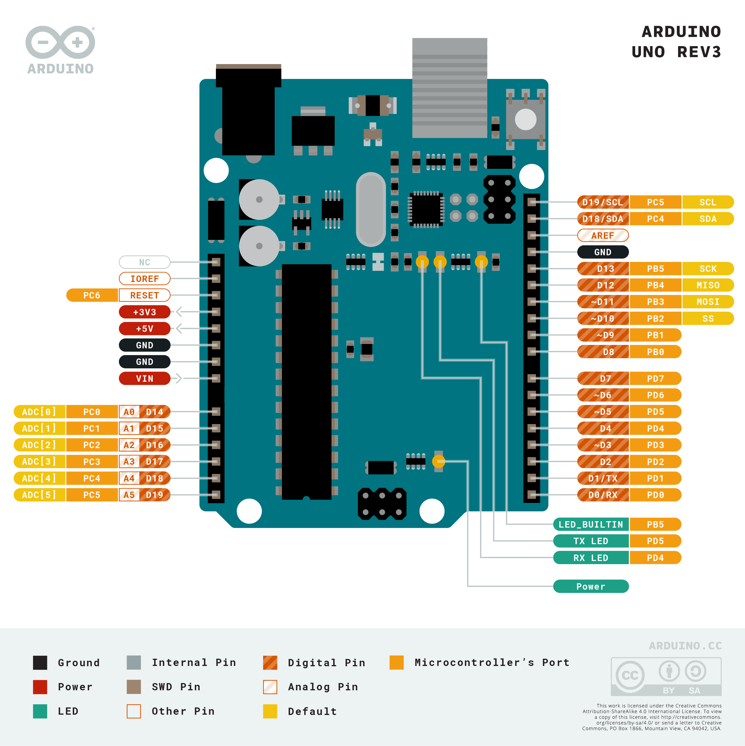
Part 1: Introduction
Arduino Uno

Slide 10
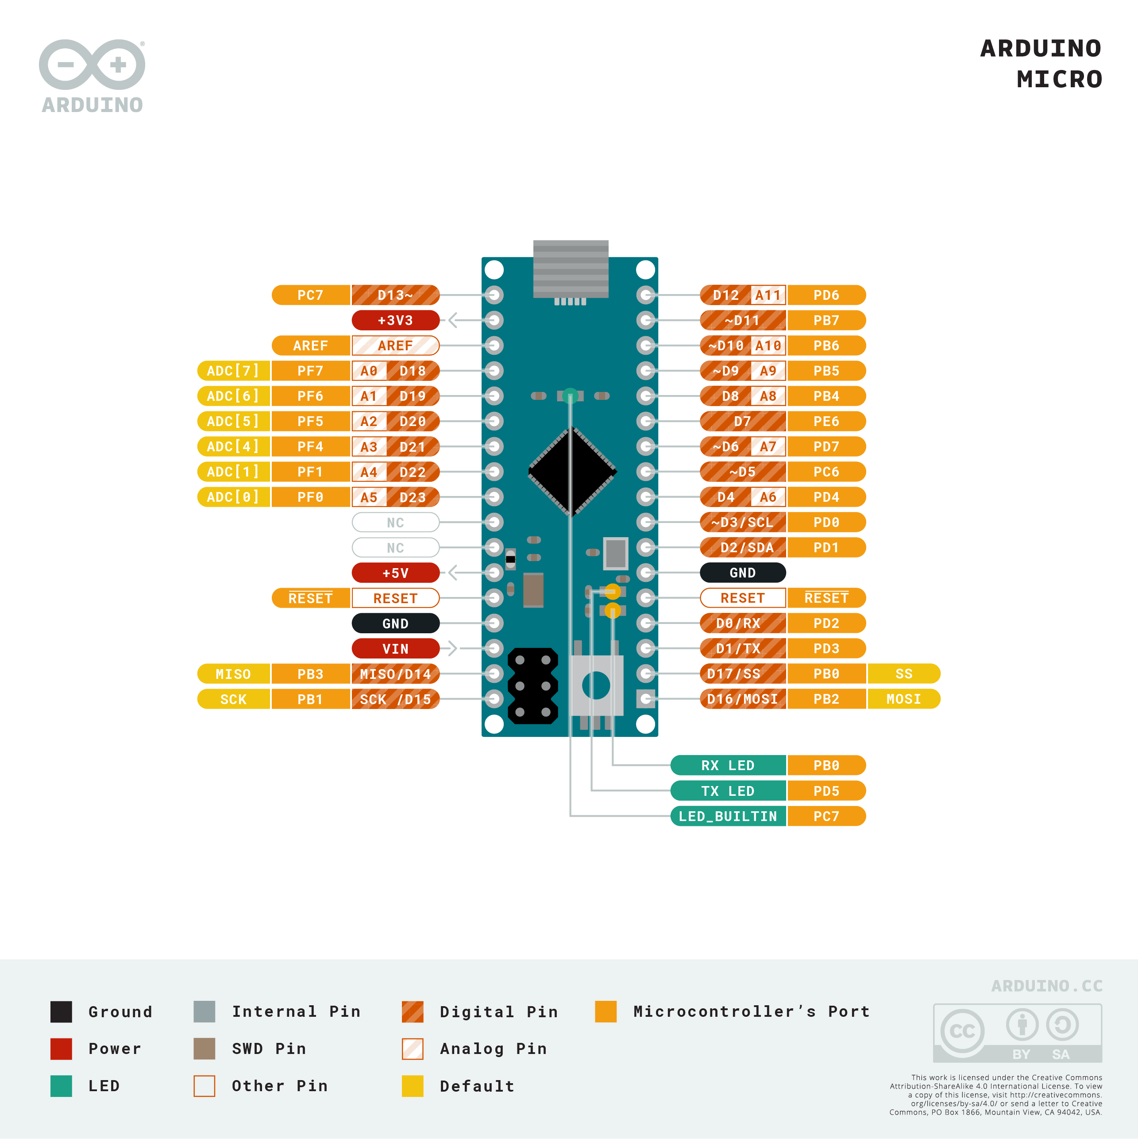
Part 1: Introduction
Arduino Micro

Slide 11
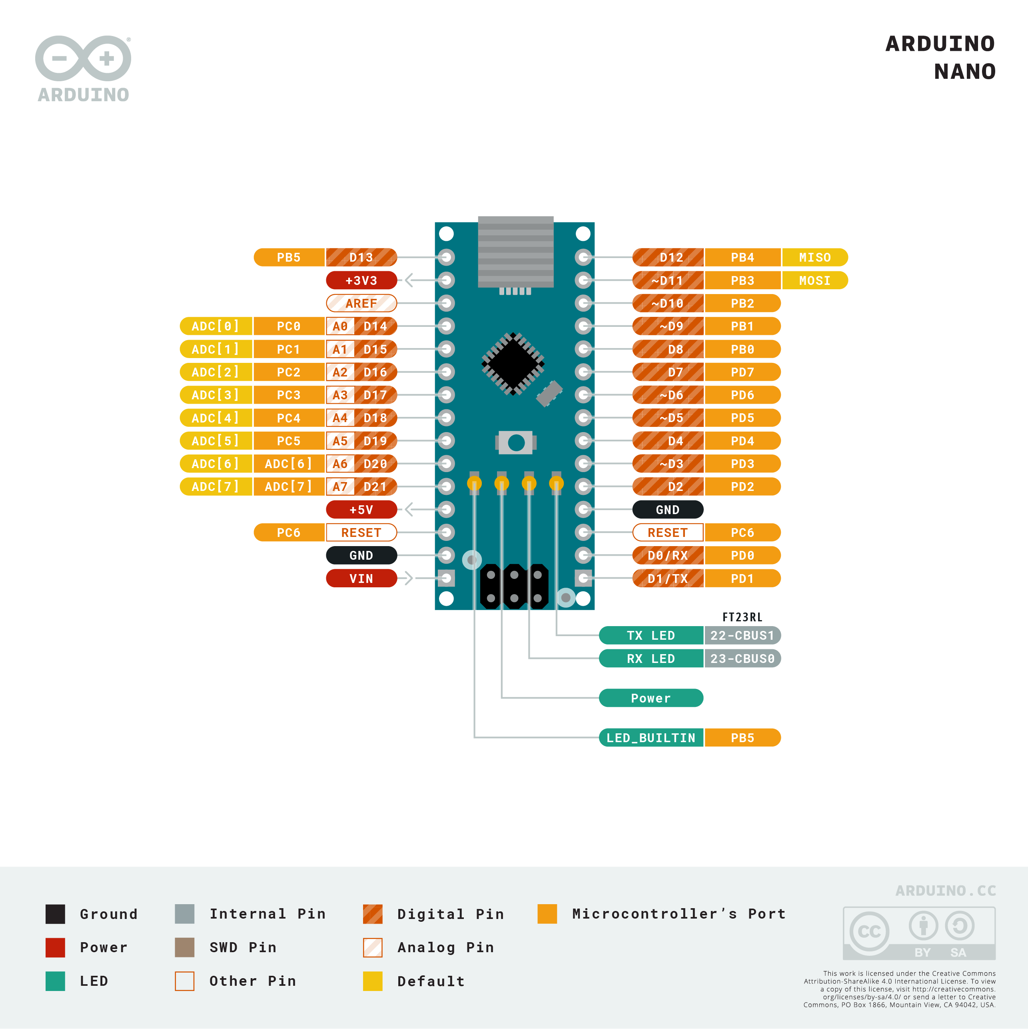
Part 1: Introduction
Arduino Nano

Slide 12
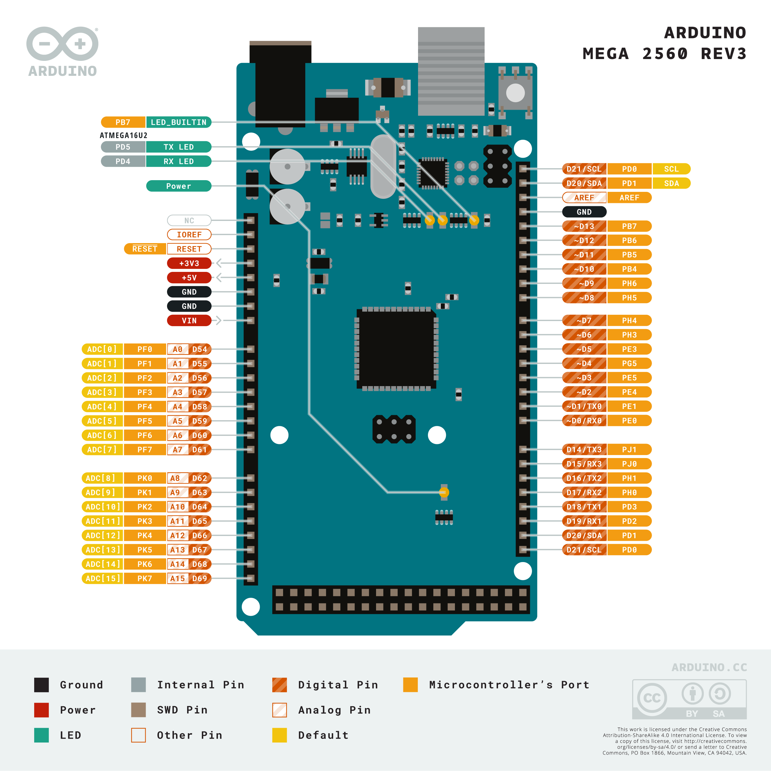
Part 1: Introduction
Arduino Mega

Slide 13
Part 1: Introduction
Technical Specifications of Each Arduino Board Shown Earlier
 | Arduino Uno | Arduino Micro | Arduino Nano | Arduino Mega
Microcontroller | ATmega328P | ATmega32U4 | ATmega328 | ATmega2560
Operating Voltage (V) | 5
Input Voltage (V) | 7 -12 | 7 – 9 | 7 -12 | 7 – 12
Clock Speed (MHz) | 16
Flash Memory (KB) | 32 |  |  | 256
SRAM (KB) | 2 | 2.5 | 2 | 8
EEPROM (KB) | 1 |  |  | 4
PWM / Digital I/O Pins | 6 / 14 | 7 / 20 | 6 / 22 | 15 / 54
Analog Input Pins | 6 | 12 | 8 | 16

Slide 14
Part 1: Introduction Add-On: Sensors
What is a Sensor?
A sensor is any device or system that detects any change in its surroundings and converts the data into electrical signals. These electrical signals are sent to another electronic device capable of processing these signals (in our case, the MCU).

Slide 15
Part 1: Introduction Add-On: Sensors
What are Analog and Digital Signals?
Analog Signals | Digital Signals
Continuous (ex. 0, 0.1, 0.01, 0.001, 0.0001, …) | Discrete (ex. Alphabet)
In electronics, these signals are usually represented by sine waves. | In electronics, these signals are usually represented by square waves.
Uses an infinite amount of values to represent data. | Uses finite values to represent data.

Slide 16
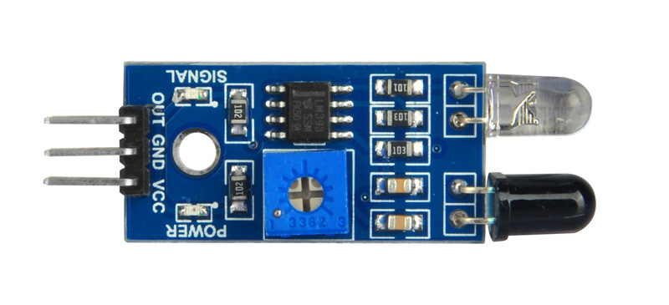
Part 1: Introduction Add-On: Sensors
Common Sensors Used with Arduino Boards
 | Name | Description / How it Works
 | Photoresistor / Light Dependent Resistor (LDR) | Acts like a potentiometer but only light can change its resistance. The more light it receives, the lesser its resistance gets.
 | Infrared Obstacle Avoidance Sensor | The IR LED (the white one) emits IR light. If there are obstacles in the IR light’s path, it will bounce back and be read by the receiver (the black one).
 | Ultrasonic Sensor | One of its “eyes” (the one marked with T) emits ultrasonic pulses forward. The receiver (the one marked with R) receives the pulses bounced back from its front. It determines distance by measuring the time lapses between sending and receiving the sound pulses.

Slide 17
Part 2: The Arduino Uno Board

Slide 18
Part 2: The Arduino Uno Board
Arduino Uno Technical Specifications
Microcontroller | ATmega328P
Operating Voltage (V) | 5 V
Input Voltage (recommended) (V) | 7 – 12 V
Input Voltage (limit) (V) | 6 – 20 V
Digital I/O Pins | 14 (6 provide PWM output)
PWM Digital I/O Pins | 6
Analog Input Pins | 6
DC Current per I/O Pin (mA) | 20 mA
DC Current for 3.3 V Pin (mA) | 50 mA
Flash Memory (KB) | 32 KB (0.5 KB used by bootloader)
SRAM (KB) | 2 KB
EEPROM (KB) | 1 KB
Clock Speed (MHz) | 16 MHz
Length (mm) | 68.6 mm
Width (mm) | 53.4 mm
Weight (grams) | 25 grams

Slide 19
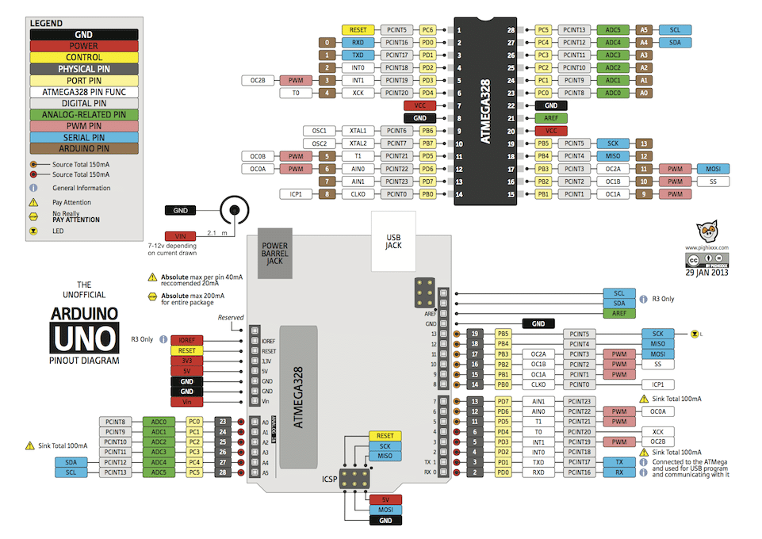
Part 2: The Arduino Uno Board
Flash Memory
will contain the sketch (the code you wrote)
Static RAM (SRAM)
the memory that the MCU will use when manipulating variables during runtime
EEPROM
Electrically Erasable Programmable Read-Only Memory
the memory that you can use to store data long-term
~ 100 000 writes before showing signs of degradation
Pulse Width Modulation (PWM)
a method of modulation where data is represented by varying the width of a DC voltage
GPIO
General Purpose Input Output

Slide 20
Part 2: The Arduino Uno Board
Ways to Power the Board
Using USB Cable
The USB port of the Arduino Uno can be connected to a desktop or laptop. If the computer recognizes the device, the current supplied to the board is 500 mA at 5 V. Otherwise, 100m A is supplied at 5 V. For the demo in Part 4, we will be using this method.
Using an AC to DC Adapter Plugged into the Barrel Connector
The barrel connector can be supplied with an input of 7 – 12 V. This is regulated to 5 V by the onboard voltage regulator, and the board is powered on.

Slide 21
Part 2: The Arduino Uno Board
Ways to Power the Board
Using 5 V Input Pin
The Arduino Uno board can also be powered using the 5 V and GND pins, given that the input voltage is steady and regulated 5 V. The 5 V pin does not pass through the board’s voltage regulator and all the safety measures present on the Arduino Uno, so if the input exceeds 5 V (5.5 V being the maximum upper limit), the board can be damaged. It is generally advised to avoid powering up the Arduino Uno using this method.

Slide 22
Part 2: The Arduino Uno Board
Ways to Power the Board
Using Batteries Greater Than 5 V
Connect a 9 V battery with the positive terminal connected to the Vin pin and the negative terminal connected to the GND pin. The Vin port allows an input between 7 and 12 V but using a 9 V battery is recommended. Depending on your application you can input 12 V too but make sure the current values stay around 500 mA.

Slide 23

Part 3: Programming Basics

Slide 24

Common Data Types

Slide 25
Part 2: Programming Basics
Common Data Types:
String (String)
The String type is used to store a sequence of characters (text). This is not a built-in type, but it behaves like one in its most basic usage. String values must be surrounded by double quotes.
Example: String x = “This is a string.”;
Boolean (bool)
A bool holds one of two values, true or false.
Each bool variable occupies one byte (8 bits) of memory.

Slide 26
Part 2: Programming Basics
Common Data Types:
Byte (byte)
A byte stores an 8-bit unsigned number, from 0 to 255.
Integer (int)
The integer data type uses 4 bytes (32 bits) of memory and stores whole numbers.
Signed: - 2 147 483 647 to + 2 147 483 647
Unsigned: 0 to 4 294 967 294

Slide 27
Control STatements

Slide 28
Control Statements
bool p1 = trainIsAppoaching();
bool p2 = vehicleWantsToCross();
if (p1 && p2) {
blockTheIntersection();
}
doOtherTasks();
if … else
In an if statement, if the specified condition/s are met, then the code inside the if block is executed. Otherwise, it will “skip” the if block.

Slide 29
Control Statements
bool p1 = trainIsAppoaching();
bool p2 = vehicleWantsToCross();
if (p1 && p2) {
blockTheIntersection();
} else {
openTheIntersection();
}
doOtherTasks();
if … else
In an if … else statement, if the specified conditions in the if statement are not met, the code in the else block is executed.

Slide 30
Control Statements
bool p1 = trainIsAppoaching();
bool p2 = trainIsCrossing();
bool p3 = trainHasPassedThrough();
if (p1) {
blockTheIntersection();
} else if (p2) {
blockTheIntersection();
} else if (p3) {
openTheIntersection();
} else {
checkForApproachingTrain();
}
doOtherTasks();
else if
else if statements are used to specify a new condition to test, if the first condition is false.

Slide 31
Control Statements
int situation = currentSituation();
switch (situation) {
case noApproachingTrain:
openTheIntersection();
break;
case trainIsApproaching:
blockTheIntersection();
break;
case trainIsCrossing:
blockTheIntersection();
break;
case trainHasPassed:
openTheIntersection();
break;
default:
checkForApproachingTrain();
break;
}
doOtherTasks();
switch … case
A switch statement compares the value of a variable to the values specified in case statements. When a case statement is found whose value matches that of the variable, the code in that case statement is run.

Slide 32
Common Loop Statements

Slide 33
Common Loop Statements
byte end = 255;
byte i = 0;
for (i; i <= end; i ++) {
sendToRegister(i);
delay(100);
}
for loop
used to repeat a block of statements enclosed in curly braces. An increment counter (usually i) is used to increment and terminate the loop.

Slide 34
Common Loop Statements
byte end = 256;
byte i = 0;
while (i < end) {
sendToRegister(i);
delay(100);
i ++;
}
while loop
will loop continuously until the expression inside the parenthesis becomes false. Something must change the tested variable, or the while loop will never exit.

Slide 35

Part 4: Demo (Shift Register)

Slide 36
Part 4: Demo (Shift Register)
What is a Shift Register?
A shift register allows you to expand the number of I/O pins you can use from your Arduino board (or any MCU for that matter).
The 74HC595 shift register (nicknamed ‘595’), is a popular shift register used for these configurations.
These are often used for the purpose of saving pins on the microcontroller, as every microcontroller has a limited number of I/O pins (GPIO).

Slide 37
Part 4: Demo (Shift Register)
74HC595 Pins | 74HC595 Pins
Pin Number | Label | Description
8 | GND (ground) | Circuit ground
9 | Q7’ (serial data output) | Overflowing bits go here
10 | MR (master reset) | LOW = reset, HIGH = don’t reset
11 | SH_CP (clock) | Clock
12 | ST_CP (latch) | LOW = unlock, HIGH = lock
13 | OE (output enabled) | LOW = show output, HIGH = hide output
14 | DS (data) | Input data
16 | VCC (voltage supply) | Voltage source
1, 2, 3, 4, 5, 6, 7, 15 | Qx (output) | Output

Slide 38
Part 4: Demo (Shift Register)
Bit Representation at the Output Pins
 | Output Pins
 | Q0 | Q1 | Q2 | Q3 | Q4 | Q5 | Q6 | Q7
MSBFIRST 2^{n} | 2⁷ | 2⁶ | 2⁵ | 2⁴ | 2³ | 2² | 2¹ | 2⁰
Output Value | 128 | 64 | 32 | 16 | 8 | 4 | 2 | 1
LSBFIRST 2^{n} | 2⁰ | 2¹ | 2² | 2³ | 2⁴ | 2⁵ | 2⁶ | 2⁷
Output Value | 1 | 2 | 4 | 8 | 16 | 32 | 64 | 128
Most Significant Bit (MSB)
the leftmost bit in a bit representation
Least Significant Bit (LSB)
the rightmost bit in a bit representation

Slide 39
Part 4: Demo (Shift Register)
Bit Representation at the Output Pins
 | Output Pins
 | Q0 | Q1 | Q2 | Q3 | Q4 | Q5 | Q6 | Q7
MSBFIRST 2^{n} | 2⁷ | 2⁶ | 2⁵ | 2⁴ | 2³ | 2² | 2¹ | 2⁰
Output Value | 128 | 64 | 32 | 16 | 8 | 4 | 2 | 1
LSBFIRST 2^{n} | 2⁰ | 2¹ | 2² | 2³ | 2⁴ | 2⁵ | 2⁶ | 2⁷
Output Value | 1 | 2 | 4 | 8 | 16 | 32 | 64 | 128
Bit Representation Examples
Sample Value (base 10) | Output Bit Representation (base 2)
 | MSBFIRST | LSBFIRST
0 | 00000000 | 00000000
1 | 00000001 | 10000000
127 | 01111111 | 11111110
170 | 10101010 | 01010101
255 | 11111111 | 11111111

Slide 40
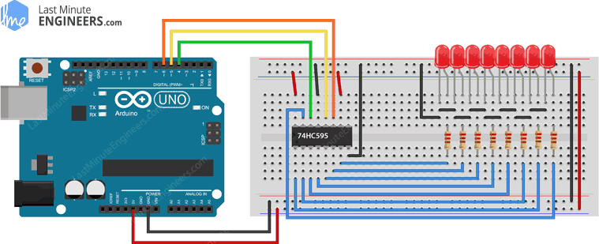
Setup
Pin Setup
Arduino Pin | 74HC595 Pin
D4 | Pin 14 (DS)
D5 | Pin 12 (ST_CP)
D6 | Pin 11 (SH_CP)
5V | Pin 10 (MR) Pin 16 (VCC)
GND | Pin 08 (GND) Pin 13 (OE)

Slide 41
Demo Code
https://github.com/acmacunlay/arduino-shift-register-demo/blob/main/arduino-shift-register-demo.ino

Slide 42
References
https://www.allaboutcircuits.com/technical-articles/what-is-a-microcontroller-introduction-component-characteristics-component/
https://components101.com/articles/difference-between-microprocessor-and-microcontroller
https://www.arduino.cc/en/guide/introduction
https://store.arduino.cc/usa/arduino-uno-rev3
https://store.arduino.cc/usa/arduino-micro
https://store.arduino.cc/usa/arduino-nano
https://store.arduino.cc/usa/mega-2560-r3
https://www.researchgate.net/figure/Figure-A1-Arduino-Uno-Pinout_fig57_275651047
https://technobyte.org/2016/07/power-up-the-arduino-uno/
https://www.w3schools.com/cpp/cpp_data_types_string.asp
https://www.arduino.cc/reference/en/language/variables/data-types/byte/
https://www.arduino.cc/reference/en/language/variables/data-types/bool/
https://www.w3schools.com/cpp/cpp_conditions.asp
https://www.arduino.cc/reference/en/language/structure/control-structure/switchcase/
https://www.arduino.cc/reference/en/language/structure/control-structure/for/
https://www.arduino.cc/reference/en/language/structure/control-structure/while/
https://lastminuteengineers.com/74hc595-shift-register-arduino-tutorial/
https://www.oomlout.com/oom.php/products/ardx/
https://www.electronics-lab.com/project/3-wire-serial-lcd-using-a-shift-register/

